Slide 1
Working with Views
PRAVINKUMAR DABADE

Slide 2
Agenda –
Introduction to ASP.NET MVC View
Introduction to Different View Types
Introduction to Razor
Syntax for Generating/Creating Views
Introduction to Layout
Working with HTML Helper Methods
Introduction to Partial Views
Introduction to XSS

Slide 3
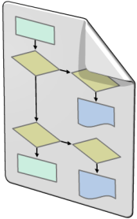


Introduction to View
Models
Model objects are the parts of the application that implement the logic for the application's data domain
Views
Views are the components that display the application's user interface (UI)
Controllers
Controllers are the components that handle user interaction, work with the model, and select a view to render the UI

Slide 4
Introduction to Views
Views are the components which are used to display the User Interfaces of the application.
Views are created with the extensions –
.CSHTML
.VBHTML
You can take help of Razor syntax to build the views for your application
Views can display the data which comes from database or other storage media.
You can generate views using ASP.NET MVC Model and Scaffold them to perform CRUD operations

Slide 5
ASP.NET MVC View Types
You can create different types of views under ASP.NET MVC.
There are mainly two types of views which you can generate –
Simple View
Partial View
Simple View –
A simple view is a view which can be rendered as a web page to your client browser. You can compare it with a Web Form.
Partial View –
A partial view is not a complete view. It is a part of simple view. You can compare the same with User Control of ASP.NET Web Form.

Slide 6
Razor Templates
Template
Data
Client Output
+
=

Slide 7
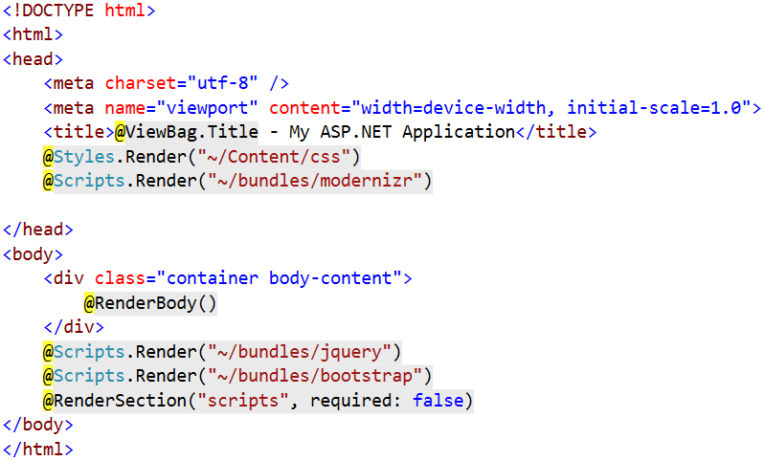
ASP.NET MVC – Layout Page

Slide 8
ASP.NET MVC – Layout Page
@RenderBody()–
This method is used to render Child page/view.
It is same as Content Place Holder in ASP.NET.
You can have only one @RenderBody() method in a Layout page.

Slide 9
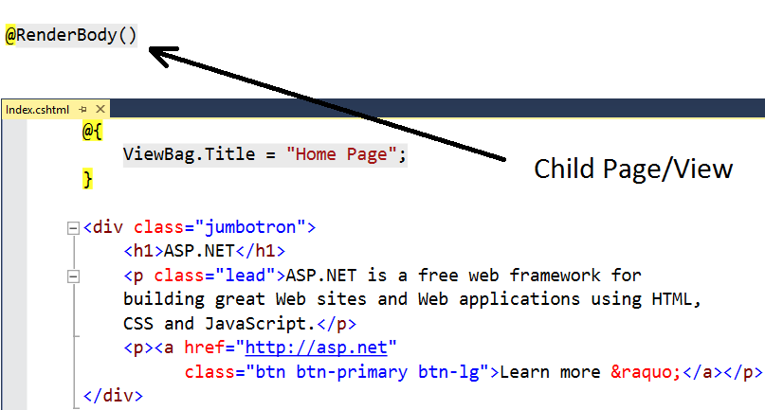
Example - @RenderBody()

Slide 10
ASP.NET MVC – Layout Page
@RenderSection() –
This method is used to render the content of a named section.
By default @RenderSection() requires the content to be declared in a page/view.
If you don’t want to make it compulsory, declare it with false parameter –
@RenderSection("scripts", required: false)

Slide 11
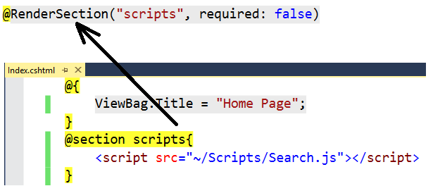
Example – @RenderSection()

Slide 12
ASP.NET MVC – HTML Helper Methods
Html is a property of the ViewPage base class
It offers number of methods which can be used to render standard Html contents
For example – You can create –
Inputs
Links
Forms

Slide 13
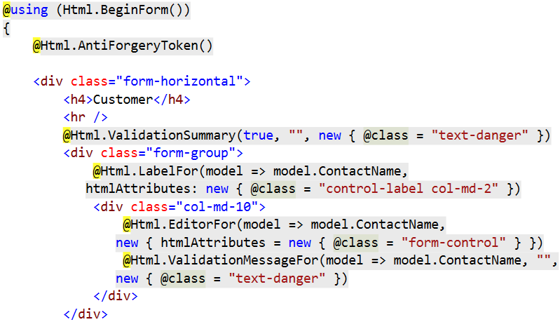
HTML Helper Method Example

Slide 14
Build-In Standard Helper Methods
Method Name | Output of the Method
@Html.TextBox(“txtName", “Pravin R. D.") | Generates Textbox field
@Html.TextArea(“txtAddress", "val", 3, 10, null) | Generates TextArea field
@Html.Password(“txtPassword", “Html@1234") | Generates Password field
@Html.CheckBox(“chkAgreement", false) | Generates Checkbox field
@Html.RadioButton(“Gender", “Male", true) | Generates Radio button field
@Html.DropDownList (“drpCountries”, new SelectList(new [] {“India", “Dubai“, “U.K”})) | Generates Dropdown list field
@Html.Hidden(“message", “Dev23788237") | Generates a Hidden Field
@Html.ListBox(“traveledCountries”, new MultiSelectList(new [] {“India", “Dubai“, “U.K”})) | Generates a multi-select List box

Slide 15
Strongly Typed Helper Methods
Method Name | Output of the Method
@Html.TextBoxFor(m=>m.ContactName) | Generates Textbox field
@Html.TextAreaFor(m=>m.Address , 5, 20, new{})) | Generates TextArea field
@Html.PasswordFor(m=>m.Password) | Generates Password field
@Html.CheckBoxFor(m=>m.Agreed) | Generates Checkbox field
@Html.RadioButtonFor(m=>m.Gender, “Male") | Generates Radio button field
@Html.DropDownListFor(m => m.Countries, new SelectList(new [] {“India", “Dubai“, “U.K”})) | Generates Dropdown list field
@Html.HiddenFor(m=>m.message, “Dev23788237") | Generates a Hidden Field
@Html.ListBoxFor(m=>m.TravelledCountries, new MultiSelectList(new [] {“India", “Dubai“, “U.K”})) | Generates a multi-select List box

Slide 16
Template HTML Helper Methods
@Html.Display – Display a read-only view of a specified model property and works on the data type of a property.
@Html.DisplayFor – It is a strongly typed method of Display which takes a model property and display the view as read-only.
@Html.Editor – Display an editable field based on the model property by choosing the appropriate HTML field.
@Html.EditorFor – It is a strongly typed method of Editor which takes a model property and display the editable field by choosing the appropriate HTML field.

Slide 17
Validation HTML Helper Methods
@Html.ValidationMessageFor(model => model.ContactName, "", new { @class = "text-danger" })
Returns the HTML mark up for a validation-error message for each data field that is represented by the specified expression.
@Html.ValidationSummary(true, "", new { @class = "text-danger" })
Returns an unordered list of validation messages that are in the ModelStateDictionary object.

Slide 18
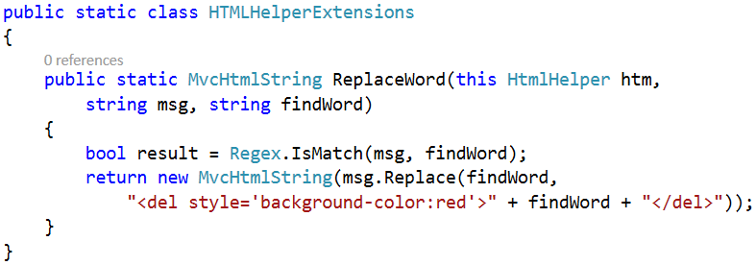
Writing Customer Helper Method

Slide 19
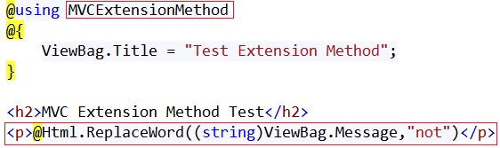
Using Custom Helper Method

Slide 20
Partial View
Partial View –
Render portion of a view
Reusable pieces of a view
It is similar to User Control in ASP.NET Web Forms
Razor partial views also have the same extension as views –
.cshtml
.vbhtml

Slide 21
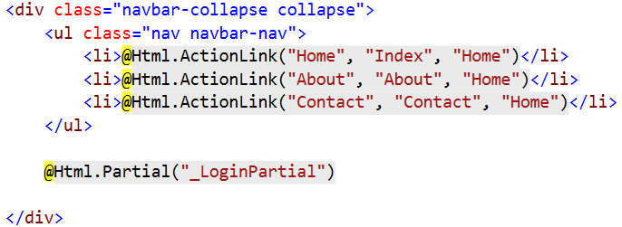
Using Partial View

Slide 22
Cross Site Request Forgery [CSRF]
To avoid CSRF attacks, we can make use of @Html.AntiForgeryToken()
Need a ValidateAntiForgeryToken attribute on controller action
It is valid only for POST operators

Slide 23
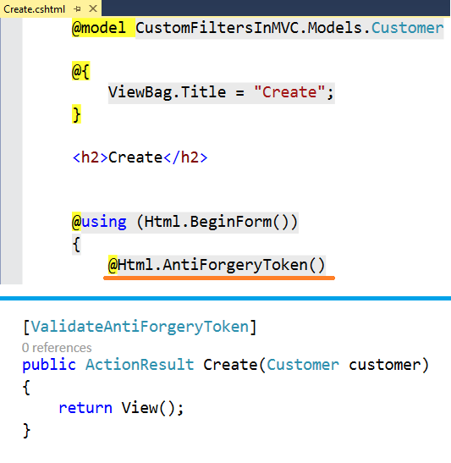
Cross Site Request Forgery [CSRF]

Slide 24
Summary
Introduction to ASP.NET MVC View
Introduction to Different View Types
Introduction to Razor
Syntax for Generating/Creating Views
Introduction to Layout
Working with HTML Helper Methods
Introduction to Partial Views
Introduction to XSS

